Slide 1
Discrete Structures
CH 01: Logic and Proofs

Slide 2
Content
The Foundations: Logic and Proofs
Propositional Logic
Applications of Propositional Logic
Propositional Equivalences
Predicates and Quantifiers
Nested Quantifiers
Rules of Inference
Introduction to Proofs
Proof Methods and Strategy

Slide 3
Propositional Equivalences
Tautology
A compound proposition that is always true
Contradiction
A compound proposition that is always false
Contingency
A compound proposition that is neither a tautology nor a contradiction
Definition 1:

Slide 4
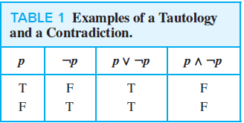

Propositional Equivalences
EXAMPLE 1: Consider the truth tables of $p ∨ ¬p$ and $p ∧ ¬p$.
Because $p ∨ ¬p$ is always true, it is a tautology.
Because $p ∧ ¬p$ is always false, it is a contradiction.
Solution:

Slide 5

Propositional Equivalences
Definition 2: The notation $p ≡ q$ or $p⟺q$ means that $p$ and $q$ are logically equivalent.
$p$ and $q$ are logically equivalent when $p⟷q$ is a tautology.

Slide 6
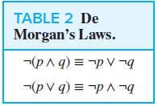
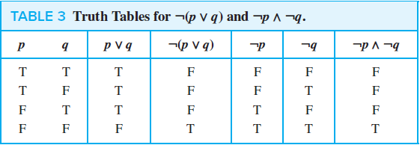

Propositional Equivalences
Example 2: Show that $¬(p ∨ q)$and $¬p ∧ ¬q$ are logically equivalent.
This is De-Morgan law
Solution:

Slide 7
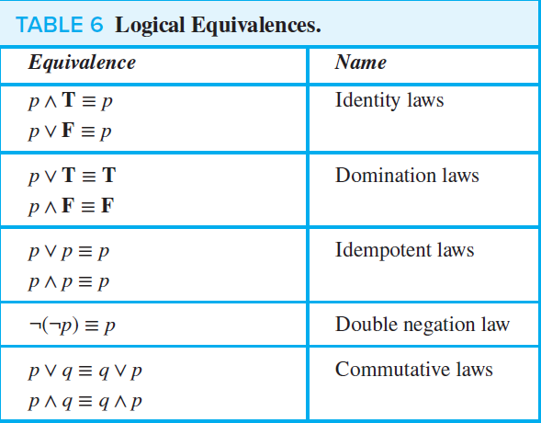
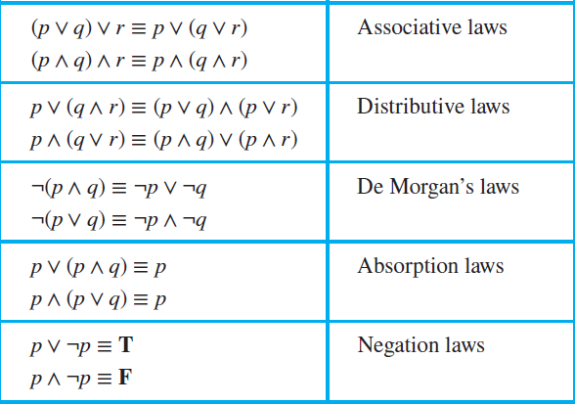
Propositional Equivalences
Table 6 contains some important equivalences.

Slide 8
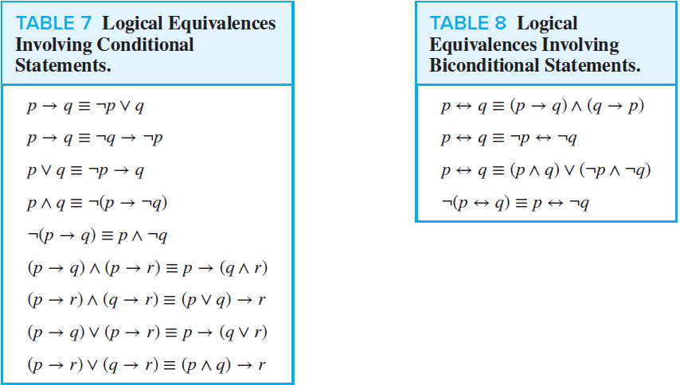
Propositional Equivalences

Slide 9

Propositional Equivalences
The notation $\bigvee_{j =1}^{n}{p_{j}}$ means $p_{1} ∨ p_{2} ∨⋯∨ p_{n}$
The notation $\bigwedge_{j =1}^{n}{p_{j}}$ means $p_{1} ∧ p_{2} ∧⋯∧ p_{n}$.

Slide 10
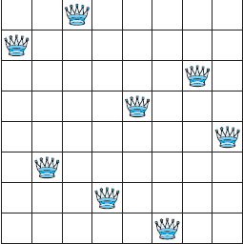
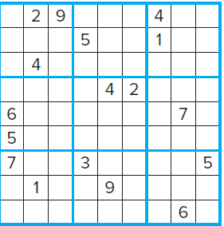

Propositional Equivalences
Satisfiability:
A compound proposition is satisfiable if there is an assignment of truth values to its variables that makes it true. $(p ∨ ¬q) ∧ (q ∨ ¬r) ∧ (r ∨ ¬p)$
A compound proposition is unsatisfiable when the proposition is false for all assignments of truth values to its variables. $\left(p ∨ ¬q\right)∧ \left(q ∨ ¬r\right)∧ \left(r ∨ ¬p\right)∧ \left(p ∨ q ∨ r\right)∧ \left(¬p ∨ ¬q ∨ ¬r\right)$
Applications of Satisfiability:
The n-queens problem
Sudoku

Slide 11
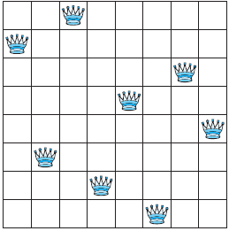

Propositional Equivalences
The n-queens problem: The n-queens problem asks for a placement of n queens on an $n × n$ chessboard so that no queen can attack another queen.
This means that no two queens can be placed in the same row, in the same column, or on the same diagonal.

Slide 12

Propositional Equivalences
To model the n-queens problem as a satisfiability problem,
We introduce $n^{2}$ variables, $p(i, j)$ for $i = 1, 2,…, n$ and$j = 1, 2,…, n$.
For a given placement of a queens on the chessboard, $p(i, j)$ is true when there is a queen on the square in the $ith$ row and $jth$ column and is false otherwise.
squares $(i, j)$ and $(i′, j′)$are on the same diagonal if either $i + i′ = j + j′$ or $i − i′ = j − j′$.
False
True

Slide 13

Propositional Equivalences
To solve the n-queen problem, we assert the following rule: $Q = Q_{1} ∧ Q_{2} ∧ Q_{3} ∧ Q_{4} ∧ Q_{5}$
Every row contains at least one queen.
There is at most one queen in each row
No column contains more than one queen
No diagonal contains two queens
No diagonal contains two queens

Slide 14

Propositional Equivalences
To solve the n-queen problem, we assert the following rule: $Q = Q_{1} ∧ Q_{2} ∧ Q_{3} ∧ Q_{4} ∧ Q_{5}$
Every row contains at least one queen.
There is at most one queen in each row
No column contains more than one queen
No diagonal contains two queens
No diagonal contains two queens

Slide 15

Propositional Equivalences
To solve the n-queen problem, we assert the following rule: $Q = Q_{1} ∧ Q_{2} ∧ Q_{3} ∧ Q_{4} ∧ Q_{5}$
Every row contains at least one queen.
There is at most one queen in each row
No column contains more than one queen
No diagonal contains two queens
No diagonal contains two queens

Slide 16

Propositional Equivalences
To solve the n-queen problem, we assert the following rule: $Q = Q_{1} ∧ Q_{2} ∧ Q_{3} ∧ Q_{4} ∧ Q_{5}$
Every row contains at least one queen.
There is at most one queen in each row
No column contains more than one queen
No diagonal contains two queens
No diagonal contains two queens

Slide 17
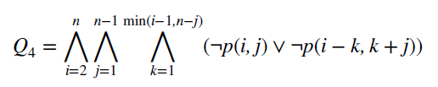
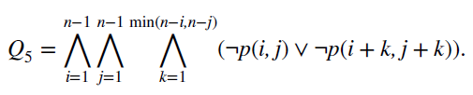
Propositional Equivalences
To solve the n-queen problem, we assert the following rule: $Q = Q_{1} ∧ Q_{2} ∧ Q_{3} ∧ Q_{4} ∧ Q_{5}$
Every row contains at least one queen.
There is at most one queen in each row
No column contains more than one queen
No diagonal contains two queens
No diagonal contains two queens

Slide 18

Exercises
3. Use truth tables to verify the commutative laws
b) $p ∧ q ≡ q ∧ p.$

Slide 19
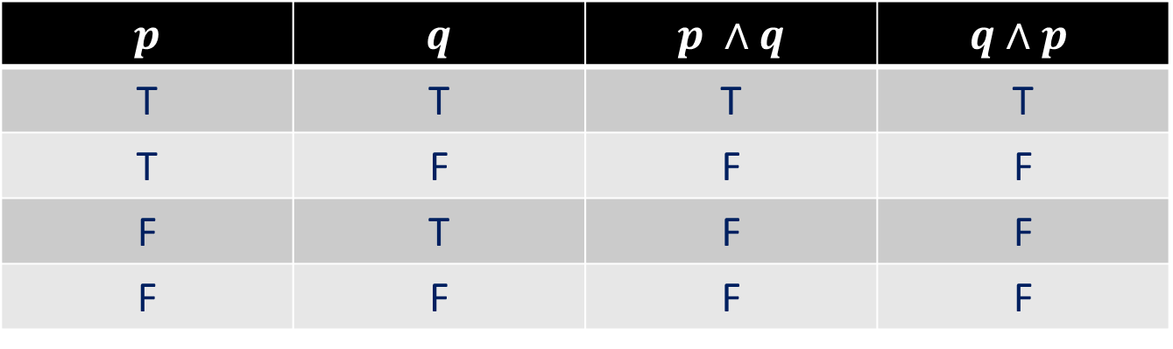
Exercises
3. Use truth tables to verify the commutative laws
b) $p ∧ q ≡ q ∧ p.$
$$p$$ | $$q$$ | $$p ∧q$$ | $$q∧p$$
T | T | T | T
T | F | F | F
F | T | F | F
F | F | F | F

Slide 20

Exercises
6. Use a truth table to verify the first De Morgan law
$$¬(p ∧ q) ≡ ¬p ∨ ¬q.$$

Slide 21
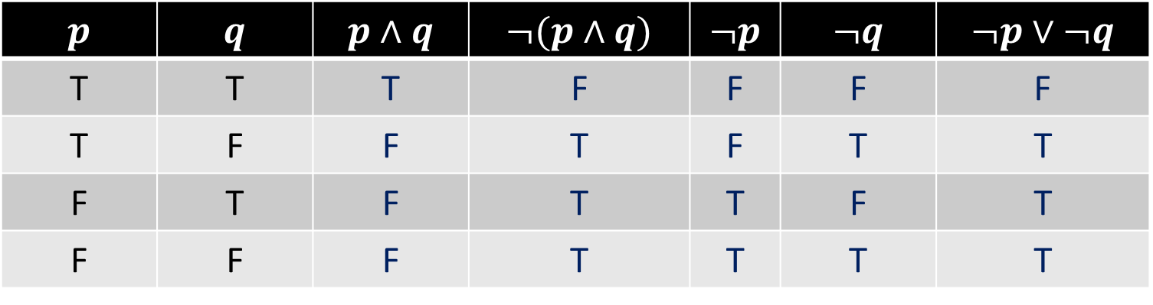
Exercises
6. Use a truth table to verify the first De Morgan law
$$¬(p ∧ q) ≡ ¬p ∨ ¬q.$$
$$p$$ | $$q$$ | $$p∧q$$ | $$¬(p∧q)$$ | $$¬p$$ | $$¬q$$ | $$¬p∨¬q$$
T | T | T | F | F | F | F
T | F | F | T | F | T | T
F | T | F | T | T | F | T
F | F | F | T | T | T | T

Slide 22

Exercises
10. For each of these compound propositions, use the conditional-disjunction equivalence (Example 3: $p → q and ¬p ∨ q$) to find an equivalent compound proposition that does not involve conditionals.
a) ¬p → ¬q
b) (p ∨ q) → ¬p
c) (p → ¬q) → (¬p → q)

Slide 23

Exercises
We apply the equivalence : $p → q and ¬p ∨ q$ to the conditionals in the original statements.
a) $¬p → ¬q ≡ p ∨ ¬q$
b) $(p ∨ q) → ¬p ≡ ¬(p ∨ q) ∨ ¬p$ by the conditional-disjunction equivalence
$≡ (¬p ∧ ¬q) ∨ ¬p$ by the second De Morgan’s law
$≡ ¬p$ by the first absorption law
c) $(p → ¬q) → (¬p → q) ≡ ¬(p → ¬q) ∨ (¬p → q)$
$≡ ¬(¬p ∨ ¬q) ∨ (¬¬p ∨ q)$
$≡ (p ∧ q) ∨ (p ∨ q)$ by the double negation and De Morgan’s laws
$≡ (p ∧ q) ∨ p ∨ q$ by the associative law
$≡ p ∨ q$ by the absorption law

Slide 24

Exercises
11. Show that each of these conditional statements is a tautology by using truth tables.
b) $p → (p ∨ q)$
d) $(p ∧ q) → (p → q)$
f ) $¬(p → q) → ¬q$

Slide 25
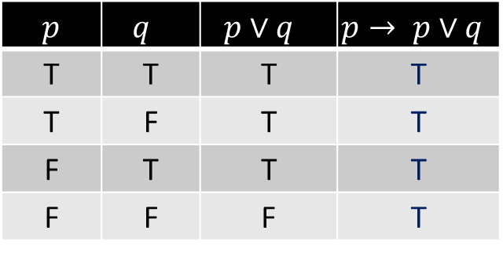
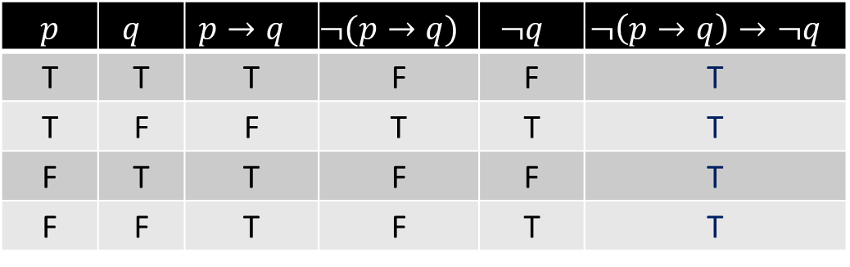

Exercises
11. Show that each of these conditional statements is a tautology by using truth tables.
b) $p → (p ∨ q)$
d) $(p ∧ q) → (p → q)$
f ) $¬(p → q) → ¬q$
$p$ | $$q$$ | $$p∨q$$ | $$p→ p∨q$$
T | T | T | T
T | F | T | T
F | T | T | T
F | F | F | T
$$p$$ | $$q$$ | $$p∧q$$ | $$p→q$$ | $$p∧q→p→q$$
T | T | T | T | T
T | F | F | F | T
F | T | F | T | T
F | F | F | T | T
$p$ | $$q$$ | $$p→q$$ | $$¬(p→q)$$ | $$¬q$$ | $$¬\left(p→q\right)→¬q$$
T | T | T | F | F | T
T | F | F | T | T | T
F | T | T | F | F | T
F | F | T | F | T | T

Slide 26

Exercises
12. Show that each of these conditional statements is a tautology by using truth tables.
a) $[¬p ∧ (p ∨ q)] → q$ b) $[(p → q) ∧ (q → r)] → (p → r)$

Slide 27
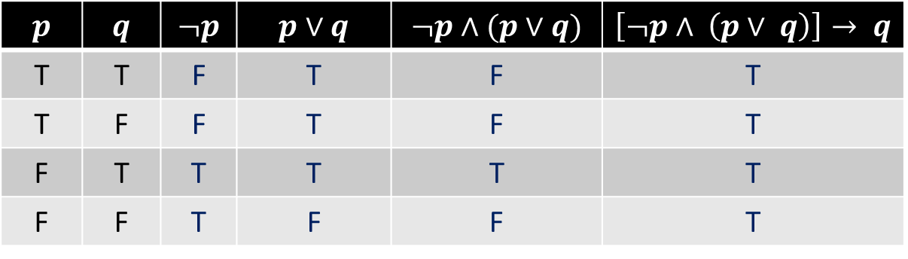

Exercises
12. Show that each of these conditional statements is a tautology by using truth tables.
a) $[¬p ∧ (p ∨ q)] → q$
$$p$$ | $$q$$ | $$¬p$$ | $$p∨q$$ | $$¬p∧(p∨q)$$ | $$\left[¬p∧ \left(p∨ q\right)\right]→ q$$
T | T | F | T | F | T
T | F | F | T | F | T
F | T | T | T | T | T
F | F | T | F | F | T

Slide 28
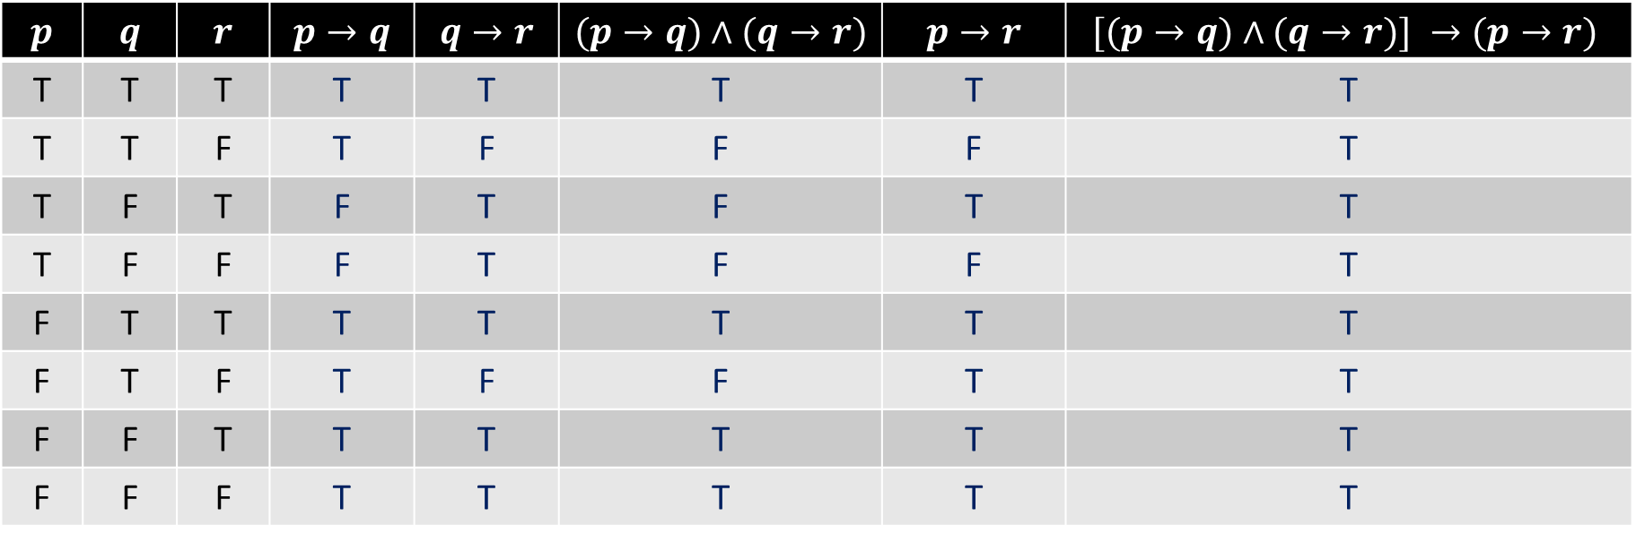

Exercises
12. Show that each of these conditional statements is a tautology by using truth tables.
b) $[(p → q) ∧ (q → r)] → (p → r)$
$$p$$ | $$q$$ | $$r$$ | $$p→q$$ | $$q→r$$ | $$(p→q)∧(q→r)$$ | $$p→r$$ | $$[(p→q)∧(q→r)] →(p→r)$$
T | T | T | T | T | T | T | T
T | T | F | T | F | F | F | T
T | F | T | F | T | F | T | T
T | F | F | F | T | F | F | T
F | T | T | T | T | T | T | T
F | T | F | T | F | F | T | T
F | F | T | T | T | T | T | T
F | F | F | T | T | T | T | T

Slide 29

Exercises
19. Determine whether $(¬q ∧ (p → q)) → ¬p$is a tautology.

Slide 30
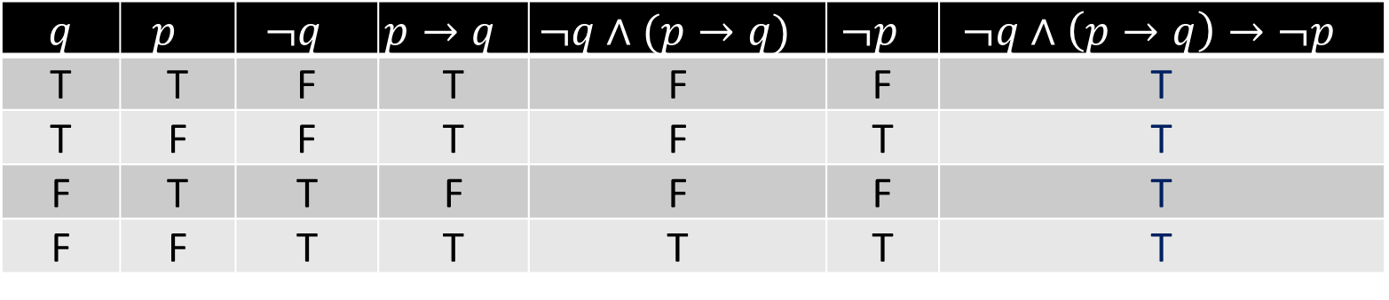

Exercises
19. Determine whether $(¬q ∧ (p → q)) → ¬p$is a tautology.
It is a tautology
$q$ | $$p$$ | $$¬q$$ | $$p→q$$ | $$¬q∧(p→q)$$ | $$¬p$$ | $$¬q∧\left(p→q\right)→¬p$$
T | T | F | T | F | F | T
T | F | F | T | F | T | T
F | T | T | F | F | F | T
F | F | T | T | T | T | T

Slide 31

Exercises
20. Show that $p ↔ q and (p ∧ q) ∨ (¬p ∧ ¬q)$are logically equivalent.

Slide 32
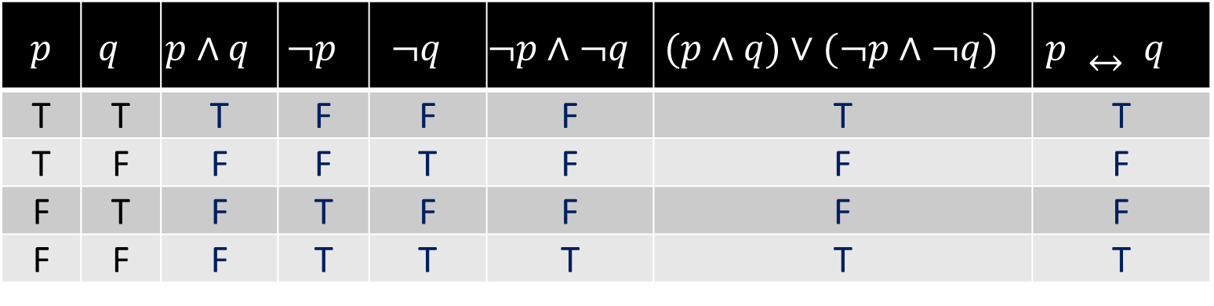
Exercises
20. Show that $p ↔ q and (p ∧ q) ∨ (¬p ∧ ¬q)$are logically equivalent.
$p$ | $$q$$ | $$p∧q$$ | $$¬p$$ | $$¬q$$ | $$¬p∧¬q$$ | $$(p∧q)∨(¬p∧¬q)$$ | $$p ↔ q$$
T | T | T | F | F | F | T | T
T | F | F | F | T | F | F | F
F | T | F | T | F | F | F | F
F | F | F | T | T | T | T | T

Slide 33

Exercises
22. Show that $p → q$and $¬q → ¬p$are logically equivalent.

Slide 34
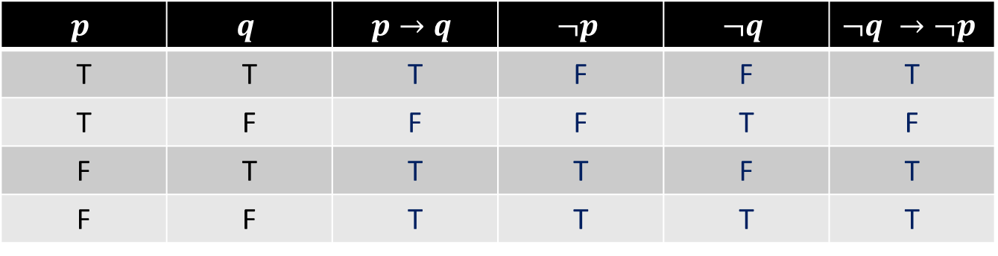
Exercises
22. Show that $p → q$and $¬q → ¬p$are logically equivalent.
$$p$$ | $$q$$ | $$p→q$$ | $$¬p$$ | $$¬q$$ | $$¬q →¬p$$
T | T | T | F | F | T
T | F | F | F | T | F
F | T | T | T | F | T
F | F | T | T | T | T

Slide 35

Exercises
36. Show that $(p ∧ q) → r$ and $(p → r) ∧ (q → r)$are not logically equivalent.

Slide 36

Exercises
36. Show that $(p ∧ q) → r$ and $(p → r) ∧ (q → r)$are not logically equivalent.
We just need to find an assignment of truth values that makes one of these propositions true and the other false.
We can let $p$ be $true$ and the other two variables be $false$. Then the first statement will be $F → F$, which is $true$, but the second will be $F ∧ T$, which is $false$

Slide 37

Exercises
A collection of logical operators is called functionally complete if every compound proposition is logically equivalent to a compound proposition involving only these logical operators.
49. Show that $¬$ and $∨$ form a functionally complete collection of logical operators.

Slide 38


Exercises
49. Show that $¬$ and $∨$ form a functionally complete collection of logical operators.
Given a compound proposition $p$, we can write down a proposition $q$ that is logically equivalent to $p$ and involves only $¬, ∧$, and $∨$.
By De Morgan’s law we can eliminate all the $∧$s by replacing each occurrence of $p_{1} ∧ p_{2} ∧ ⋯ ∧ p_{n}$ with $¬(¬p_{1} ∨ ¬p_{2} ∨ ⋯ ∨ ¬p_{n})$.

Slide 39

Exercises
62. How many of the disjunctions $p ∨ ¬q$, $¬p ∨ q$, $q ∨ r$, $q ∨ ¬r$, and $¬q ∨ ¬r$ can be made simultaneously true by an assignment of truth values to $p, q,$ and $r$?

Slide 40


Exercises
62. How many of the disjunctions $p ∨ ¬q$, $¬p ∨ q$, $q ∨ r$, $q ∨ ¬r$, and $¬q ∨ ¬r$ can be made simultaneously true by an assignment of truth values to $p, q,$ and $r$?
If we want the first two of these to be $true$, then $p$ and $q$ must have the same truth value.
If $q$ is $true$, then the third and fourth expressions will be $true$, and if $r$ is $false$, the last expression will be $true$.
So, all five of these disjunctions will be $true$ if we set $p$ and $q$ to be $true$, and $r$ to be $false$.

Slide 41

Exercises
65. Determine whether each of these compound propositions is satisfiable.
a) $(p ∨ ¬q) ∧ (¬p ∨ q) ∧ (¬p ∨ ¬q)$

Slide 42
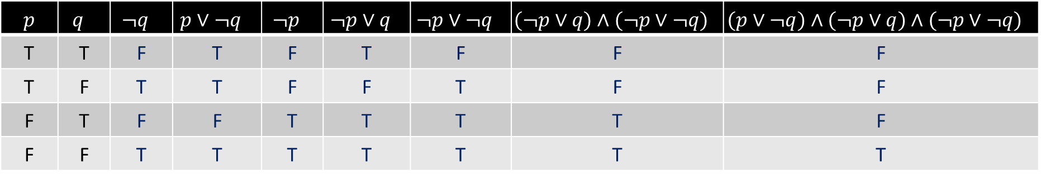

Exercises
65. Determine whether each of these compound propositions is satisfiable.
a) $(p ∨ ¬q) ∧ (¬p ∨ q) ∧ (¬p ∨ ¬q)$ Satisfiable
$p$ | $$q$$ | $$¬q$$ | $$p∨¬q$$ | $$¬p$$ | $$¬p∨q$$ | $$¬p∨¬q$$ | $$(¬p∨q)∧(¬p∨¬q)$$ | $$(p∨¬q)∧(¬p∨q)∧(¬p∨¬q)$$
T | T | F | T | F | T | F | F | F
T | F | T | T | F | F | T | F | F
F | T | F | F | T | T | T | T | F
F | F | T | T | T | T | T | T | T

Slide 43

Exercises
67. Find the compound proposition $Q$ constructed in Example 10 for the n-queens problem, and use it to find all the ways that n queens can be placed on an $n × n$chessboard, so that no queen can attack another when n is
a) 2. b) 3. c) 4.

Slide 44

Exercises
67. Find the compound proposition $Q$ constructed in Example 10 for the n-queens problem, and use it to find all the ways that n queens can be placed on an $n × n$chessboard, so that no queen can attack another when n is
a) 2.
No Solution
Q

Slide 45

Exercises
67. Find the compound proposition $Q$ constructed in Example 10 for the n-queens problem, and use it to find all the ways that n queens can be placed on an $n × n$chessboard, so that no queen can attack another when n is
b) 3. No Solution
Q
Q
Q

Slide 46

Exercises
67. Find the compound proposition $Q$ constructed in Example 10 for the n-queens problem, and use it to find all the ways that n queens can be placed on an $n × n$chessboard, so that no queen can attack another when n is
c) 4. $(1, 2), (2, 4), (3, 1), (4, 3)$ or $(1, 3), (2, 1), (3, 4), (4, 2)$
Q
Q
Q
Q
Q
Q
Q
Q

Slide 47
TASKS
Section 1.3
3 (a)
9
11 (a, c, e)
12 (c, d)
18
21
28
35
47

Slide 48
Content
The Foundations: Logic and Proofs
Propositional Logic
Applications of Propositional Logic
Propositional Equivalences
Predicates and Quantifiers
Nested Quantifiers
Rules of Inference
Introduction to Proofs
Proof Methods and Strategy

Slide 49

Predicates and Quantifiers
Predicate logic is used to solve statements involving variables, such as
“x > 3,” “x = y + 3,” “x + y = z,”
“Computer x is under attack by an intruder,”
“Computer x is functioning properly,”
The first part, the variable $x$, is the subject of the statement.
The second part of the statement is called the predicate.
The statement $P(x)$ is also said to be the value of the propositional function $P$ at $x$.

Slide 50

Predicates and Quantifiers
EXAMPLE 1: Let $P(x)$ denote the statement “$x > 3$.” What are the truth values of $P(4)$ and $P(2)$?
Solution: $P(4)$, which is the statement “4 > 3,” is $true$. However, $P(2)$, which is the statement “2 > 3,” is $false$.

Slide 51

Predicates and Quantifiers
EXAMPLE 3: Let $Q(x, y)$ denote the statement “$x = y + 3.$” What are the truth values of the propositions $Q(1, 2)$ and $Q(3, 0)$?
Solution: To obtain $Q(1, 2)$, set $x = 1$ and $y = 2$ in the statement $Q(x, y)$. Hence, $Q(1, 2)$ is the statement “$1 = 2 + 3$,” which is $false$. The statement $Q(3, 0)$ is the proposition “$3 = 0 + 3$,” which is $true$.

Slide 52
Predicates and Quantifiers
Predicates are used to establish the correctness of computer programs
To show that computer programs always produce the desired output when given valid input.
Preconditions are the statements that describe valid input.
Postconditions are the conditions that the output should satisfy when the program has run.

Slide 53


Predicates and Quantifiers
Quantification expresses the extent to which a predicate is true over a range of elements.
Quantifiers
universal quantification
existential quantification
A predicate is $true$ for every element under consideration
There is one or more element
under consideration for which the predicate is $true$.

Slide 54
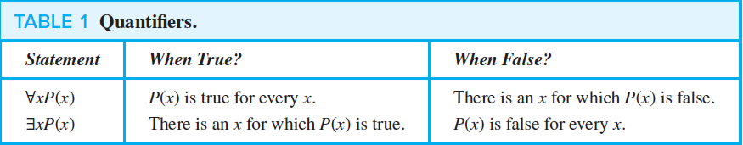
Predicates and Quantifiers

Slide 55

Predicates and Quantifiers
EXAMPLE 8: Let $P(x)$ be the statement “$x + 1 > x$.” What is the truth value of the quantification $∀xP(x)$, where the domain consists of all real numbers?
Solution: Because$P(x)$ is true for all real numbers $x$, the quantification $∀xP(x)$ is true.

Slide 56

Predicates and Quantifiers
EXAMPLE 13: Let $P(x)$ denote the statement “$x > 3$.” What is the truth value of the quantification $∃xP(x)$, where the domain consists of all real numbers?
Solution: Because “$x > 3$” is sometimes true—for instance, when $x = 4$—the existential quantification of $P(x)$, which is $∃xP(x)$, is true.

Slide 57

Predicates and Quantifiers
EXAMPLE 15: What is the truth value of $∀xP(x)$, where $P(x)$ is the statement “$x^{2} < 10$” and the domain consists of the positive integers not exceeding $4$?
Solution: The statement $∀xP(x)$ is the same as the conjunction
$P(1) ∧ P(2) ∧ P(3) ∧ P(4)$, because the domain consists of the integers 1, 2, 3, and 4. Because $P(4)$, which is the statement “$4^{2} < 10$,” is $false$, it follows that $∀xP(x)$ is $false$.

Slide 58

Predicates and Quantifiers
EXAMPLE 16: What is the truth value of $∃xP(x)$, where $P(x)$ is the statement “$x^{2} > 10$” and the universe of discourse consists of the positive integers not exceeding $4$?
Solution: Because the domain is $\{1, 2, 3, 4\}$, the proposition $∃xP(x)$ is the same as the disjunction $P(1) ∨ P(2) ∨ P(3) ∨ P(4)$. Because $P(4)$, which is the statement “$42 > 10$,” is $true$, it follows that $∃xP(x)$ is $true$.

Slide 59
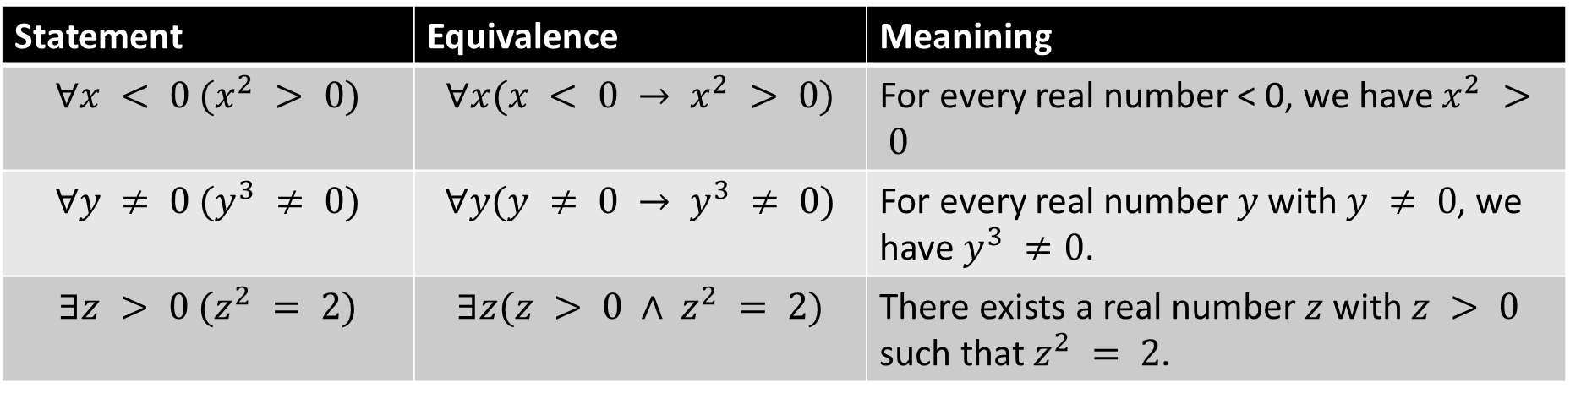

Predicates and Quantifiers
EXAMPLE 17: What do the statements $∀x < 0 (x^{2} > 0)$, $∀y ≠ 0 (y^{3} ≠ 0)$, and $∃z>0 (z^{2} = 2)$ mean, where the domain in each case consists of the real numbers?
Solution:
Statement | Equivalence | Meanining
$$∀x < 0 (x^{2} > 0)$$ | $$∀x(x < 0 → x^{2} > 0)$$ | For every real number < 0, we have $x^{2} > 0$
$$∀y ≠ 0 (y^{3} ≠ 0)$$ | $$∀y(y ≠ 0 → y^{3} ≠ 0)$$ | For every real number $y$ with $y ≠ 0$, we have$y^{3} ≠0$.
$$∃z > 0 (z^{2} = 2)$$ | $$∃z(z > 0 ∧ z^{2} = 2)$$ | There exists a real number $z$ with $z > 0$ such that $z^{2} = 2$.

Slide 60

Predicates and Quantifiers
Negation of universal quantifier: $¬∀xP(x) ≡ ∃x ¬P(x).$
Negation of existential quantifier: $¬∃xQ(x) ≡ ∀x ¬Q(x).$

Slide 61

Predicates and Quantifiers
EXAMPLE 21: What are the negations of the statements $∀x(x^{2} > x)$ and $∃x(x^{2}= 2)$?
Solution: $¬ ∀x\left(x^{2}> x\right)≡∃x¬\left(x^{2}> x\right)≡∃x\left(x^{2}≤ x\right)$ $¬∃x\left(x^{2}= 2\right)≡∀x¬\left(x^{2}= 2\right)≡∀x(x^{2}≠ 2)$

Slide 62

Exercises
1. Let $P(x)$denote the statement “$x ≤ 4.$” What are these truth values?
a) $P(0)$ b) $P(4)$ c) $P(6)$

Slide 63



Exercises
1. Let $P(x)$denote the statement “$x ≤ 4.$” What are these truth values?
a) $P(0)$ b) $P(4)$ c) $P(6)$
$0≤4$ True
$4≤4$ True
$$6≤4$$
False

Slide 64

Exercises
4. State the value of $x$ after the statement $if P(x) then x := 1$ is executed, where $P(x)$ is the statement “$x > 1$,” if the value of $x$ when this statement is reached is
a) x = 0. b) x = 1. c) x = 2.

Slide 65


Exercises
4. State the value of $x$ after the statement $if P(x) then x := 1$ is executed, where $P(x)$ is the statement “$x > 1$,” if the value of $x$ when this statement is reached is
a) x = 0. b) x = 1. c) x = 2.
This is equivalent to:
If $(x>1)$, then $x = 1$
a) Here $x$ is still equal to $0$, since the condition is $false$.
b) Here $x$ is still equal to $1$, since the condition is $false$.
c) This time x is equal to $1$ at the end, since the condition is $true$, so the statement $x := 1$is executed.

Slide 66

Exercises
5. Let $P(x)$ be the statement “$x spends more than five hours every weekday in class,$” where the domain for $x$ consists of all students. Express each of these quantifications in English.
a) $∃xP(x)$ b) $∀xP(x)$ c) $∃x ¬P(x)$ d) $∀x ¬P(x)$

Slide 67
Exercises
5. Let $P(x)$ be the statement “$x spends more than five hours every weekday in class,$” where the domain for $x$ consists of all students. Express each of these quantifications in English.
a) $∃xP(x)$ b) $∀xP(x)$ c) $∃x ¬P(x)$ d) $∀x ¬P(x)$
There is a student who spends more than 5 hours every weekday in class.
Every student spends more than 5 hours every weekday in class.
There is a student who does not spend more than 5 hours every weekday in class.
No student spends more than 5 hours every weekday in class.

Slide 68

Exercises
11. Let $P(x)$ be the statement “$x = x^{2}.$” If the domain consists of the integers, what are these truth values?
a) $P(0)$ b) $P(1)$ c) $P(2)$ d) $P(−1)$ e) $∃xP(x)$ f ) $∀xP(x)$

Slide 69
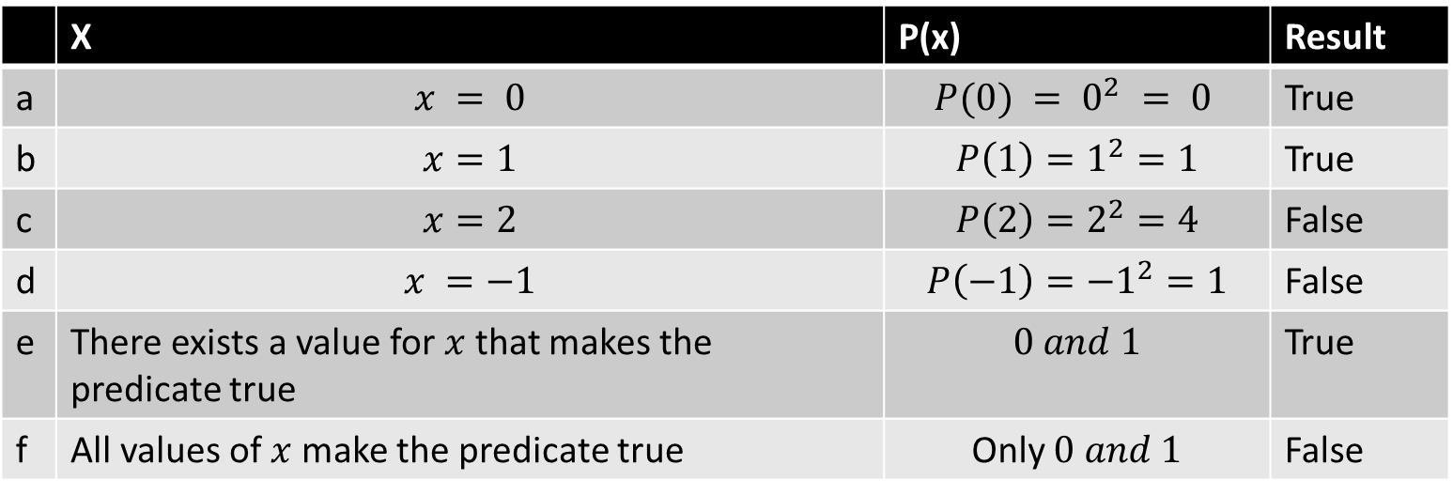
Exercises
11. Let $P(x)$ be the statement “$x = x^{2}.$” If the domain consists of the integers, what are these truth values?
a) $P(0)$ b) $P(1)$ c) $P(2)$ d) $P(−1)$ e) $∃xP(x)$ f ) $∀xP(x)$
 | X | P(x) | Result
a | $$x = 0$$ | $$P(0) = 0^{2} = 0$$ | True
b | $$x=1$$ | $P\left(1\right)=1^{2}=1$ | True
c | $$x=2$$ | $P\left(2\right)=2^{2}=4$ | False
d | $$x =−1$$ | $$P\left(−1\right)=−1^{2}=1$$ | False
e | There exists a value for $x$ that makes the predicate true | $$0 and 1$$ | True
f | All values of $x$ make the predicate true | Only $0 and 1$ | False

Slide 70

Exercises
13. Determine the truth value of each of these statements if the domain consists of all integers.
a) $∀n(n + 1 > n)$ c) $∃n(n = −n)$

Slide 71


Exercises
13. Determine the truth value of each of these statements if the domain consists of all integers.
a) $∀n(n + 1 > n)$ c) $∃n(n = −n)$
For all numbers, $n$; $n+1$ is always greater than $n$.
Try different set of numbers: $0, −1, −5, 10, 12.$
This is $True$
b) There exists a number, $n$, that is equal to its negative $(−n)$.
This is $True$ for $n=0$

Slide 72

Exercises
14. Determine the truth value of each of these statements if the domain consists of all real numbers.
a) $∃x(x^{3} = −1)$ c) $∀x({\left(−x\right)}^{2} = x^{2})$

Slide 73


Exercises
14. Determine the truth value of each of these statements if the domain consists of all real numbers.
a) $∃x(x^{3} = −1)$ c) $∀x({\left(−x\right)}^{2} = x^{2})$
There exists a number, $x$, where the cube of $x$ is $−1$.
This is $True$ for $x=−1$, such that ${\left(−1\right)}^{3}=−1$
c) For all numbers $x$, the square of the negative of $x$ is equal to the square of $x$. $${\left(−x\right)}^{2} = {\left(\left(−1\right)x\right)}^{2} = {\left(−1\right)}^{2}x^{2} = x^{2}$$
The predicate is $True$

Slide 74

Exercises
17. Suppose that the domain of the propositional function $P(x)$ consists of the integers $0, 1, 2, 3, and 4$. Write out each of these propositions using disjunctions, conjunctions, and negations.
a) $∃xP(x)$ b) $∀xP(x)$ c) ∃x¬P(x)
d) $∀x¬P(x)$ e) $¬∃xP(x)$ f )$¬∀xP(x)$

Slide 75


Exercises
17. Suppose that the domain of the propositional function $P(x)$ consists of the integers $0, 1, 2, 3, and 4$. Write out each of these propositions using disjunctions, conjunctions, and negations.
a) $∃xP(x)$ b) $∀xP(x)$ c) ∃x¬P(x)
d) $∀x¬P(x)$ e) $¬∃xP(x)$ f )$¬∀xP(x)$
a) $P(0) ∨ P(1) ∨ P(2) ∨ P(3) ∨ P(4)$
b) $P(0) ∧ P(1) ∧ P(2) ∧ P(3) ∧ P(4)$
c) $¬P(0) ∨ ¬P(1) ∨ ¬P(2) ∨ ¬P(3) ∨ ¬P\left(4\right)$
d) $¬P\left(0\right)∧ ¬P\left(1\right)∧ ¬P\left(2\right)∧¬P\left(3\right)∧ ¬P\left(4\right)$
e) $¬(P(0)∨P(1)∨P(2)∨P(3)∨P(4))$
f) $¬(P(0)∧P(1) ∧ P(2) ∧ P(3) ∧ P(4))$

Slide 76

Exercises
20. Suppose that the domain of the propositional function $P(x)$ consists of $−5, −3, −1, 1, 3$, and $5$. Express these statements without using quantifiers, instead using only negations, disjunctions, and conjunctions.
a) $∃xP(x)$ b) $∀xP(x)$ c) $∀x\left(\left(x ≠ 1\right)→ P\left(x\right)\right)$ d)$∃x((x ≥ 0) ∧ P(x))$ e) $∃x(¬P(x)) ∧ ∀x((x < 0) → P(x))$

Slide 77

Exercises
20. Suppose that the domain of the propositional function $P(x)$ consists of $−5, −3, −1, 1, 3$, and $5$. Express these statements without using quantifiers, instead using only negations, disjunctions, and conjunctions.
a) $∃xP(x)$ b) $∀xP(x)$ c) $∀x\left(\left(x ≠ 1\right)→ P\left(x\right)\right)$ d)$∃x((x ≥ 0) ∧ P(x))$ e) $∃x(¬P(x)) ∧ ∀x((x < 0) → P(x))$
a) $P\left(−5\right)∨P(−3)∨P(−1)∨P(1)∨P(3)∨P(5).$
b) $P\left(−5\right)∧ P(−3)∧P(−1)∧P(1)∧P(3)∧P(5)$
c) $P\left(−5\right)∧P(−3)∧P(−1)∧P(3)∧P(5).$
d) $P\left(1\right)∨ P(3)∨P(5).$
e) $\left(¬P\left(−5\right)∨¬P\left(−3\right)∨¬P\left(−1\right)∨¬P\left(1\right)∨¬P\left(3\right)∨¬P\left(5\right)\right)$ $$∧(P\left(−1\right)∧P\left(−3\right)∧ P(−5)).$$

Slide 78

Exercises
36. Express the negation of each of these statements in terms of quantifiers without using the negation symbol.
a) $∀x(−2 < x < 3)$
b) $∀x(0 ≤ x < 5)$
c) $∃x(−4 ≤ x ≤ 1)$
d) $∃x(−5 < x < −1)$

Slide 79

Exercises
36. Express the negation of each of these statements in terms of quantifiers without using the negation symbol.
a) $∀x(−2 < x < 3)$
b) $∀x(0 ≤ x < 5)$
c) $∃x(−4 ≤ x ≤ 1)$
d) $∃x(−5 < x < −1)$
$∃x(\left(x≤−2\right)∨ (x≥ 3))$
$∃x(\left(x < 0\right) ∨ (x≥ 5))$
$∀x(\left(x <−4\right)∨ (x > 1))$
$∀x(\left(x ≤−5\right)∨ (x ≥−1))$

Slide 80
Exercises
44. Express each of these system specifications using predicates, quantifiers, and logical connectives.
a) Every user has access to an electronic mailbox.
b) The system mailbox can be accessed by everyone in the group if the file system is locked.
c) The firewall is in a diagnostic state only if the proxy server is in a diagnostic state.
d) At least one router is functioning normally if the throughput is between 100 kbps and 500 kbps and the proxy server is not in diagnostic mode.

Slide 81
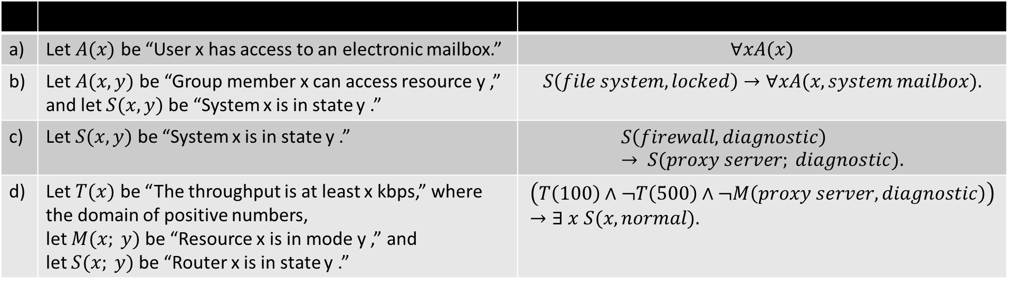
Exercises
a) | Let $A(x)$ be “User x has access to an electronic mailbox.” | $$∀xA(x)$$
b) | Let $A(x, y)$be “Group member x can access resource y ,” and let $S(x, y)$ be “System x is in state y .” | $$S\left(file system, locked\right)→∀xA(x, system mailbox).$$
c) | Let $S(x,y)$ be “System x is in state y .” | $$S\left(firewall, diagnostic\right)→ S(proxy server; diagnostic).$$
d) | Let $T(x)$ be “The throughput is at least x kbps,” where the domain of positive numbers, let $M(x; y)$be “Resource x is in mode y ,” and let $S(x; y)$be “Router x is in state y .” | $$\left(T\left(100\right)∧¬T\left(500\right)∧¬M\left(proxy server, diagnostic\right)\right)→∃ x S(x, normal).$$

Slide 82
TASKS
Section 1.4
6
12
19
43

